Slide 1
CS325 Fall 2021 Homework Assignment #3
Student ID: 440000119
Student Name: Goh Wei Zhe

Slide 2
Scenario description
John is working from home due to COVID-19 pandemic during Circuit Break. It is 12 o’clock and is time for his lunch break. John is hungry and since there is no dining in, he decided to order his lunch from ExpressFood with his smart phone. He receives his ordered food from the ExpressFood delivery man after 45 minutes of waiting.

Slide 3
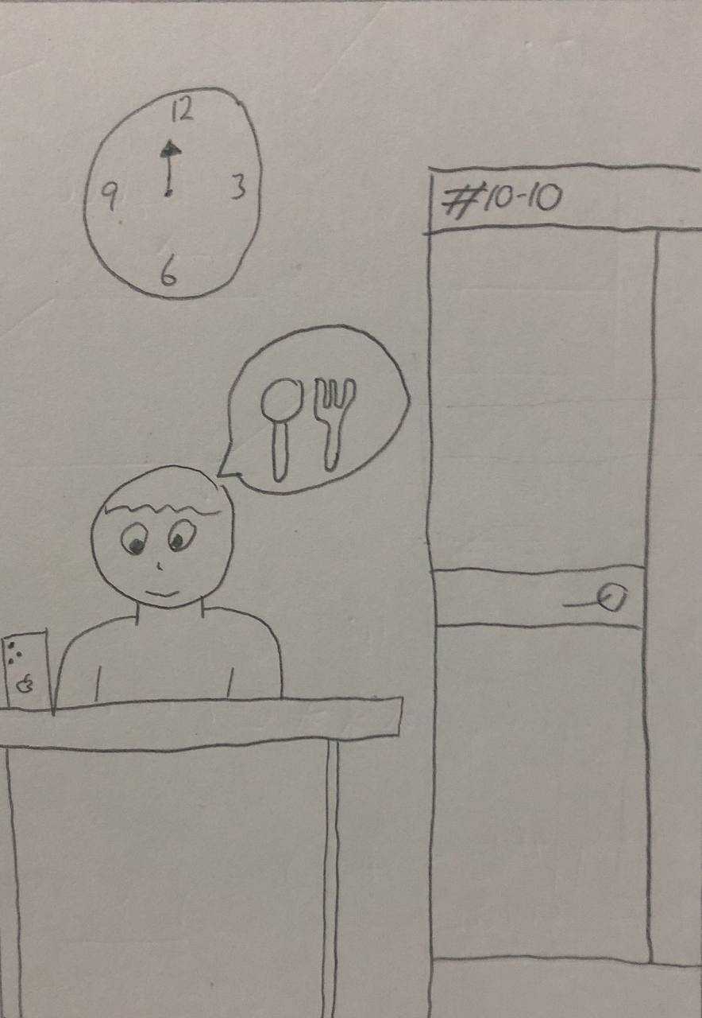
Storyboard Sketch #1
It is 12 o’clock and John is hungry. He picks up his smart phone and decides to order food delivery from the application called ExpressFood.

Slide 4
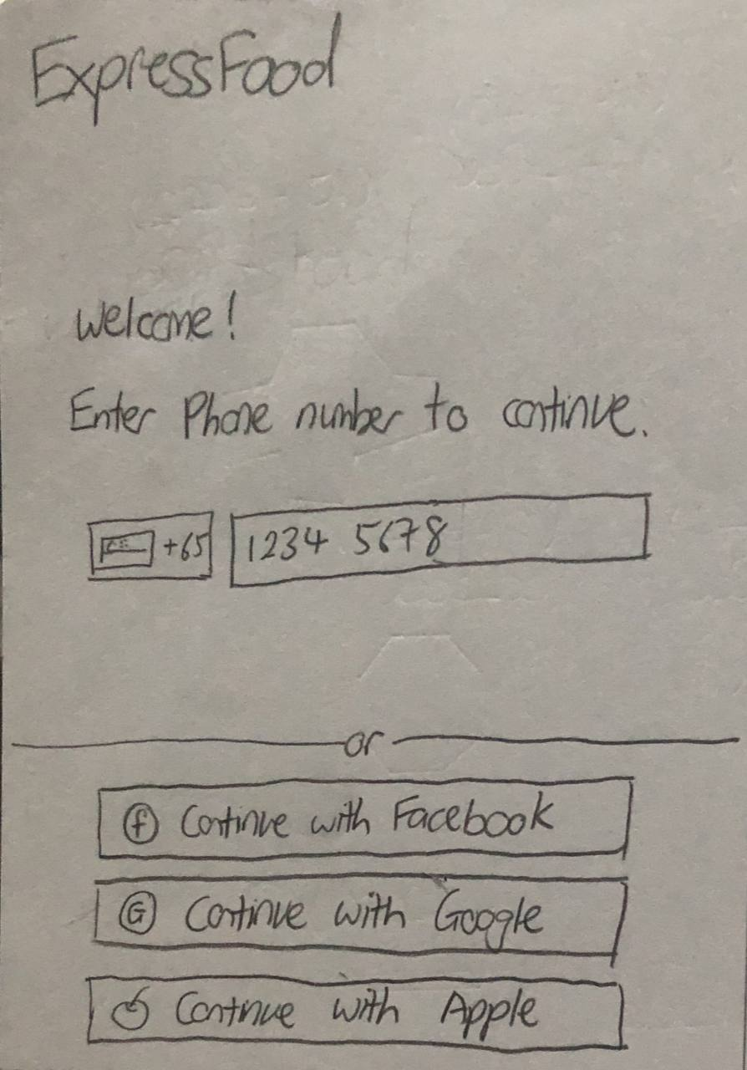
Storyboard Sketch #2
John clicks and enter the ExpressFood app where he can enter his phone number to login.
He can also use either Facebook, Google or Apple account to continue to place his order through the application.

Slide 5
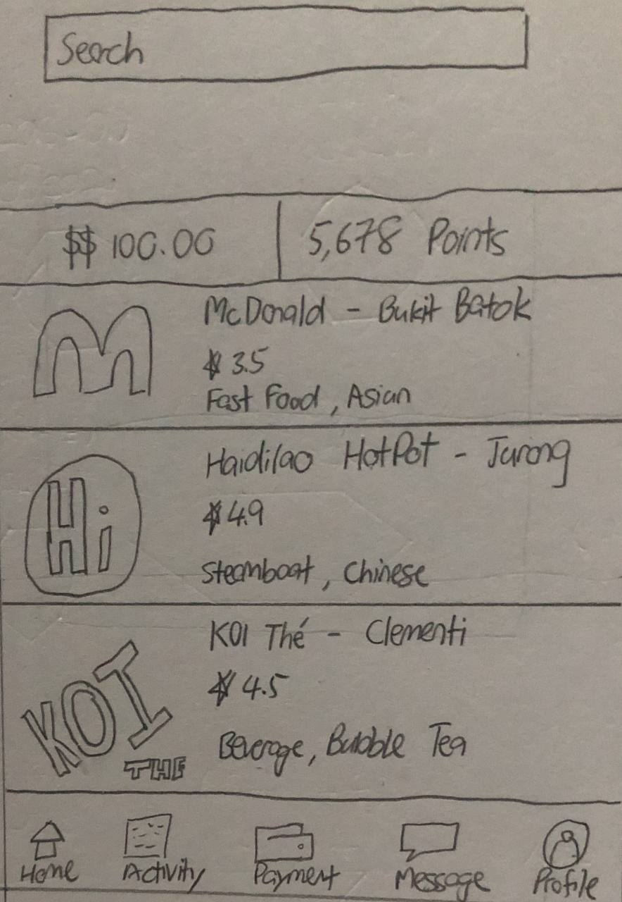
Storyboard Sketch #3
The application displays the amount of value in his wallet and the points accumulated from ordering through this application.
John can either search by typing keywords into the search box or order by browsing through the nearby restaurant that provides delivery.

Slide 6
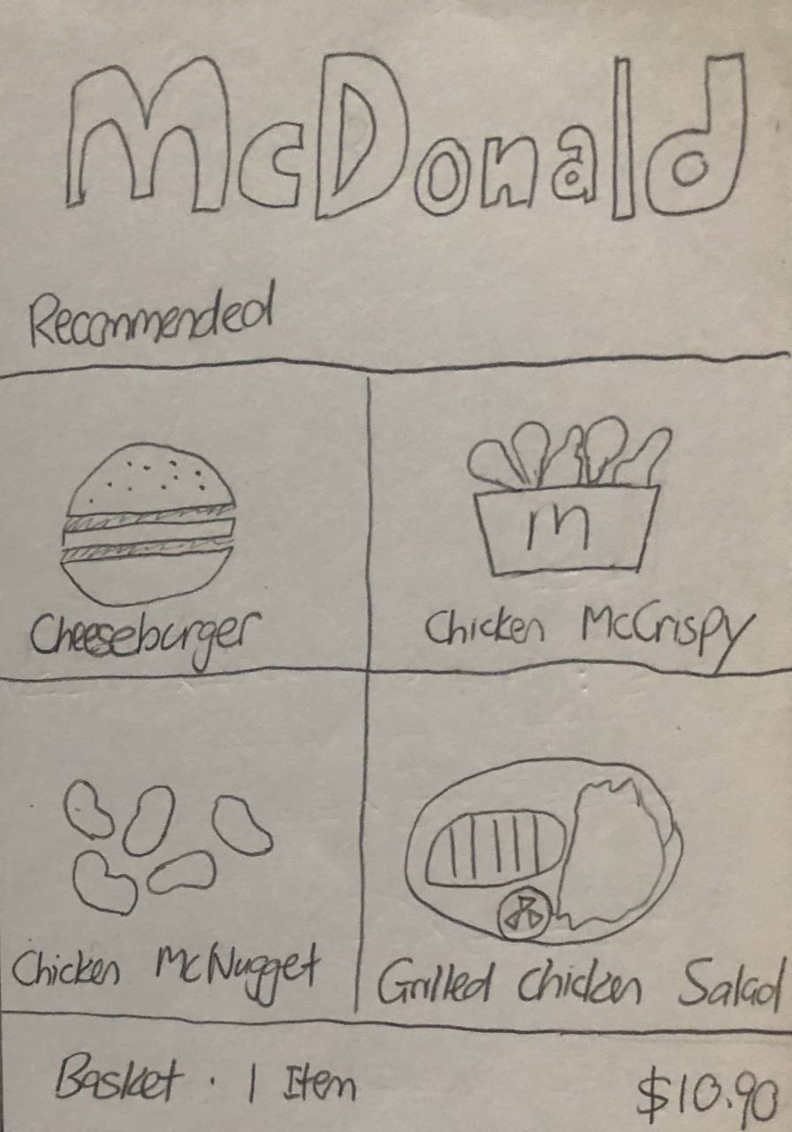
Storyboard Sketch #4
John selects McDonald and the application displays the food allowed to be delivered.
He can cart his order into the basket by tapping onto respective pictures.
The application will show the amount of items in the basket and the total price.

Slide 7
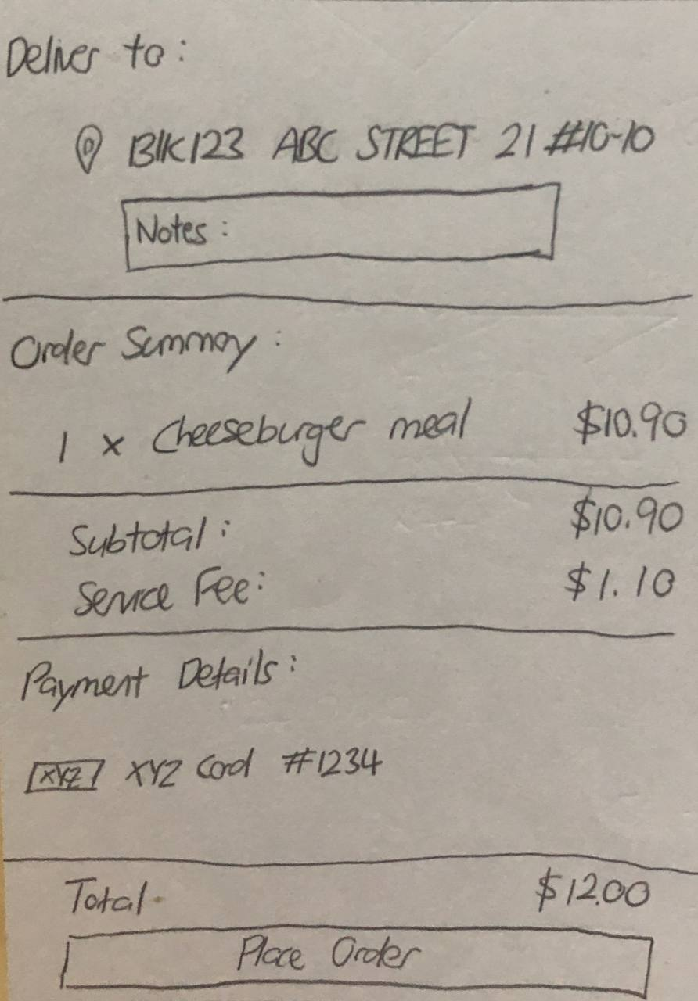
Storyboard Sketch #5
John then proceed to cart out his basket and will need to enter the delivered address and notes to be taken for the delivery man.
The application will display the order summary and the total price inclusive of additional service charges.
He can choose his payment method either through cash on delivery or card.
He needs to click on place order button to successfully order and pay for his meal

Slide 8
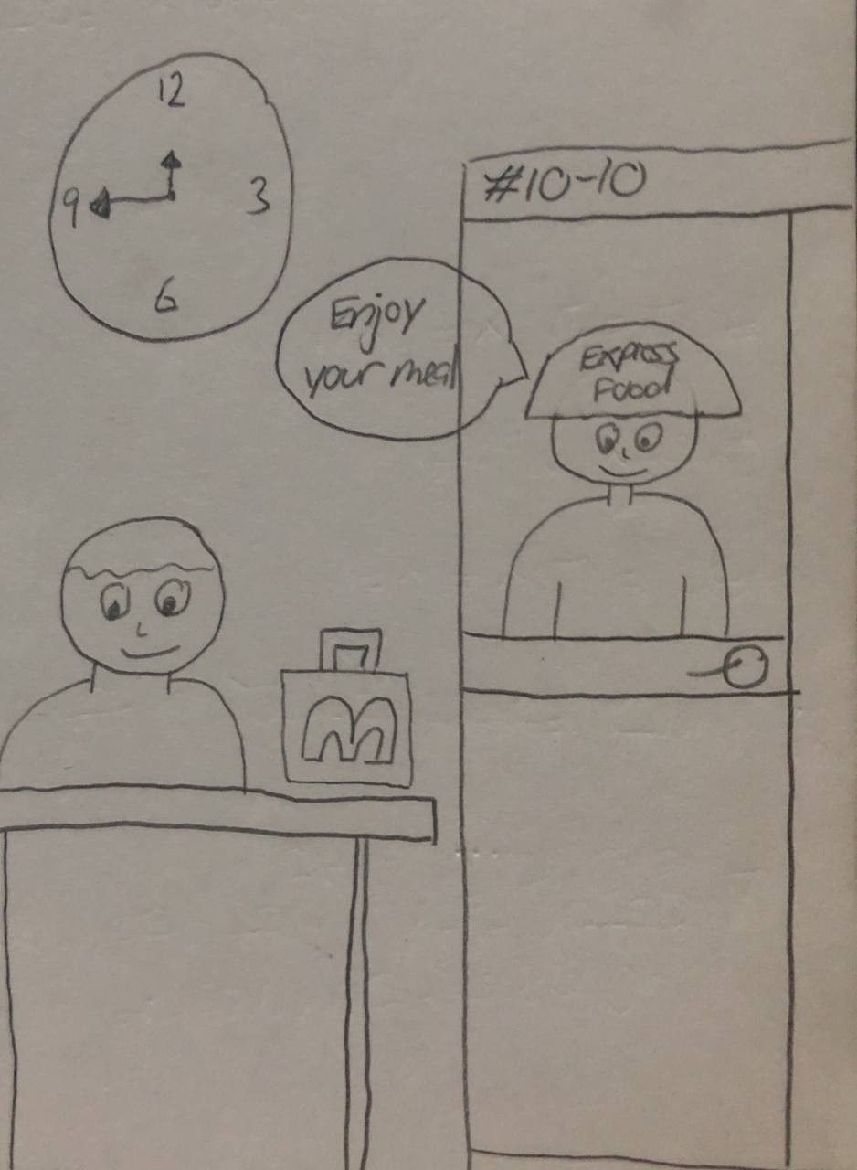
Storyboard Sketch #6
After 45 minutes after placing his order, the ExpressFood delivery man reached his doorstep. John took over his McDonald meal and enjoy his lunch break.

